Slide 1

Climate Action Week 2018

Slide 2


Slide 3


Slide 4

2016 the Hottest Year on Record since 1880

Slide 5
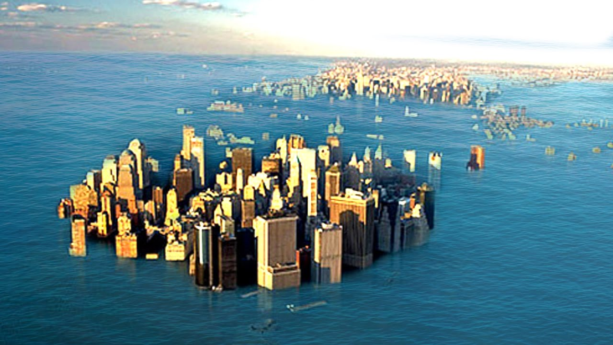
Sea Levels rising at fastest rate in recorded history

